Slide 1
#write a function that has a turtle draw a square (pass in side lengths)
#write a function that has a turtle draw a rectangle (pass in side lengths)

Slide 2
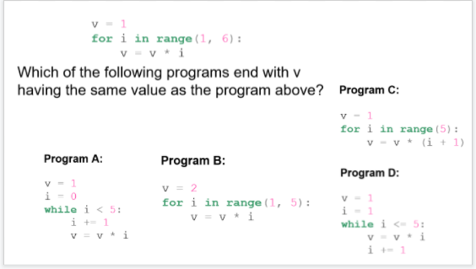

Slide 3
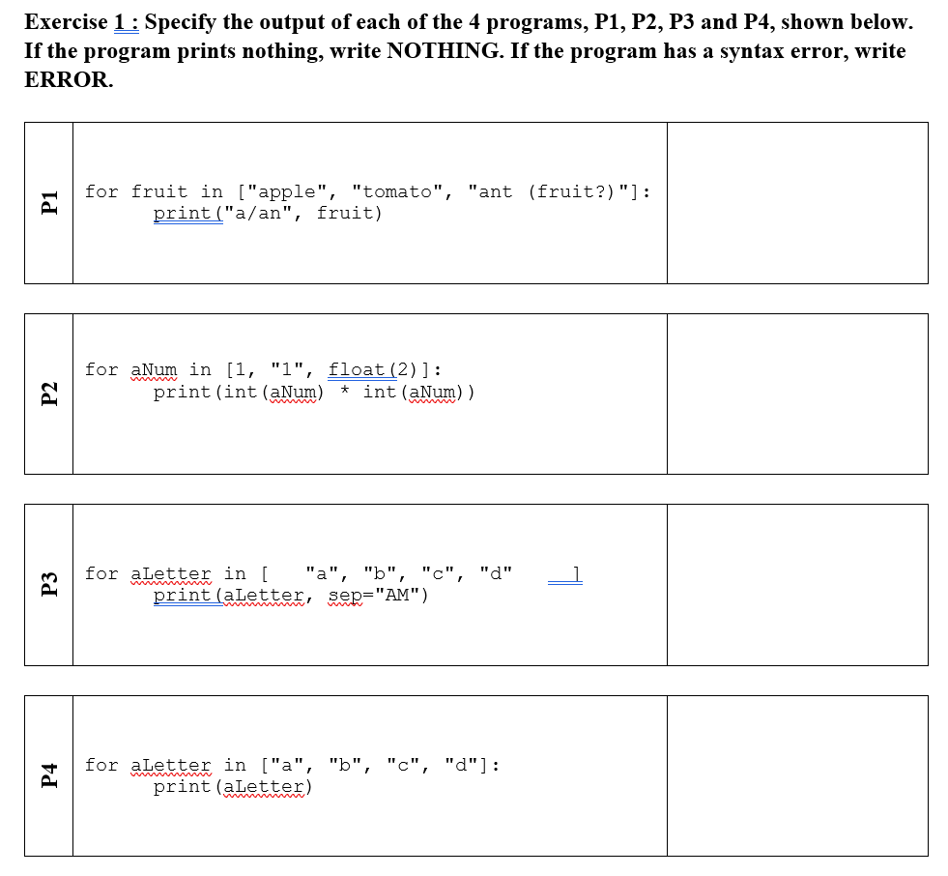

Slide 4
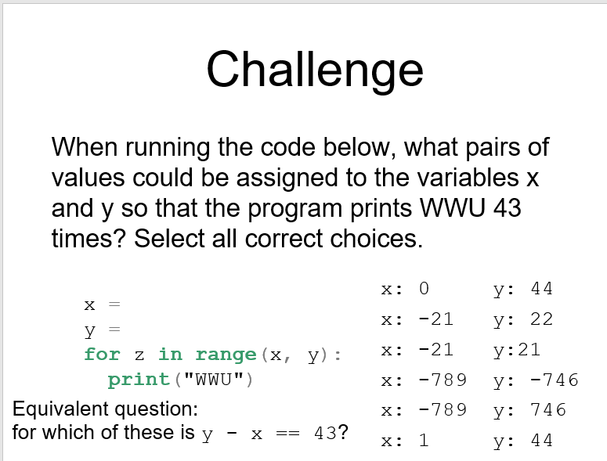

Slide 5
